Slide 1
Analytic Calculation of Multi-Loop Feynman Integrals
Long-Bin Chen(陈龙斌)
Guangzhou University
2020.08.21

Slide 2
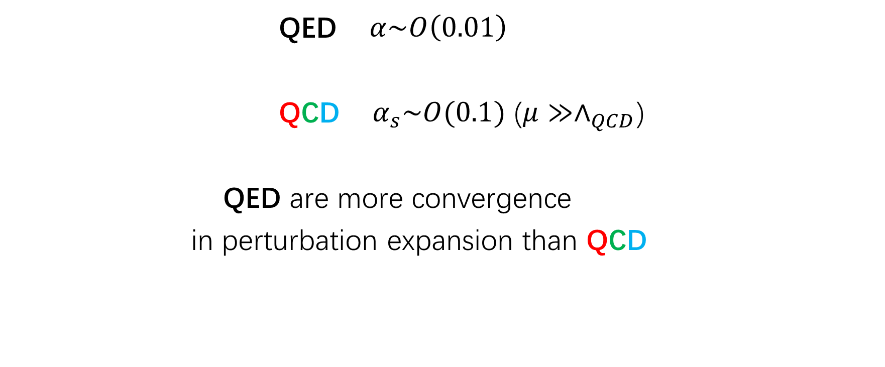
The need for higher order QCD corrections
QED $α\sim O\left(0.01\right)$
QCD $α_{s}\sim O(0.1)$ ($μ≫∧_{QCD}$)
QED are more convergence
in perturbation expansion than QCD
For higher order corrections, one of the difficult parts is the calculation of multi-loop integrals.

Slide 3
Calculations of Feynman Integrals
Method
1. Alpha and Feynman Parameters
2. Mellin-Barnes Representation
3. Integration-By-Parts (IBP)
4. Differential Equations
5. Sector Decompositions
6. Dimensional Recurrence
………
Vladmir A. Smirnov, Analytic Tools For Feynman Integrals

Slide 4
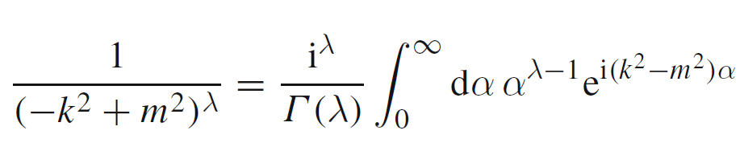
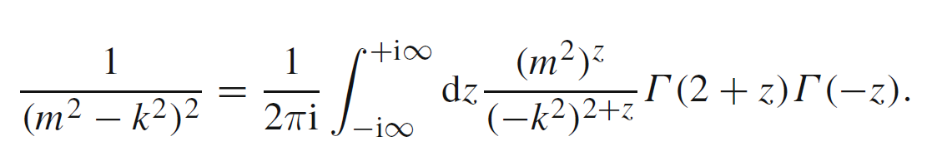
alpha representation
Mellin-Barnes Representation

Slide 5
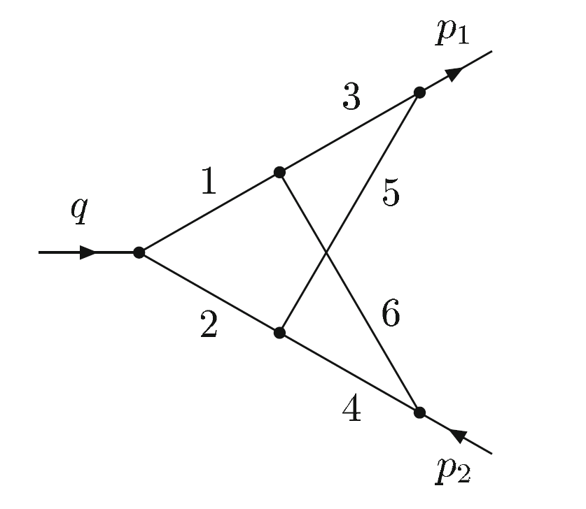
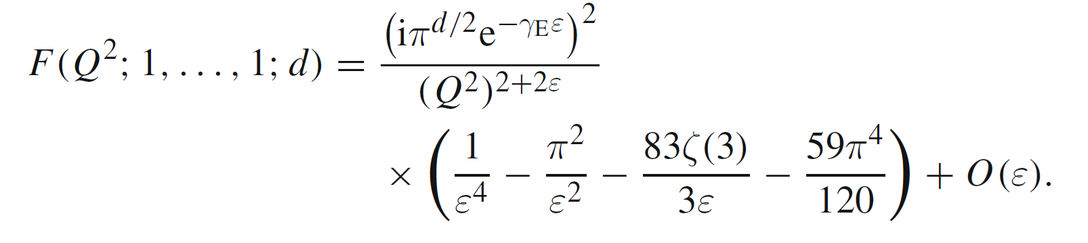
Example
Can be evaluated by Feynman parameters

Slide 6
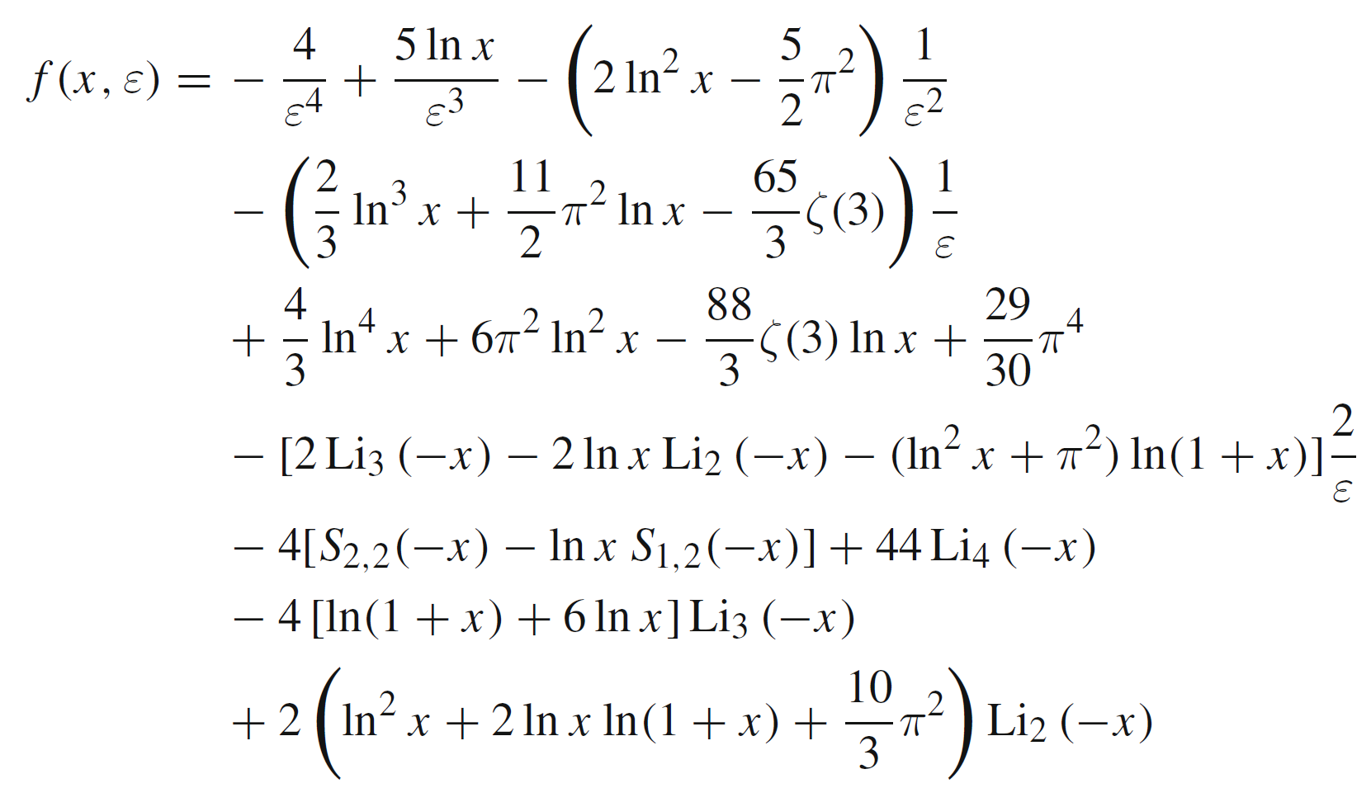
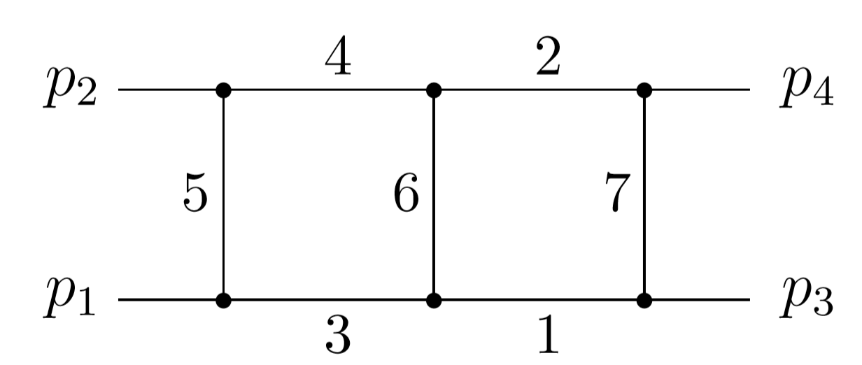
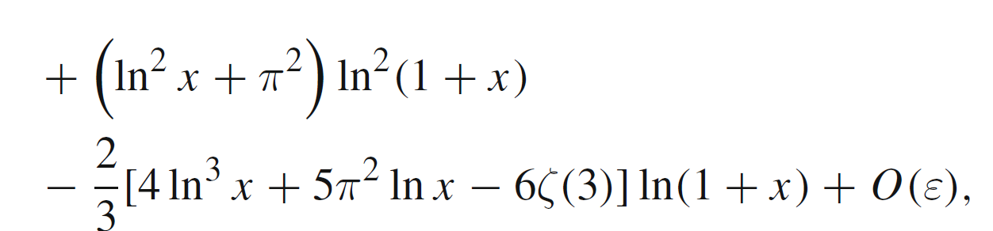
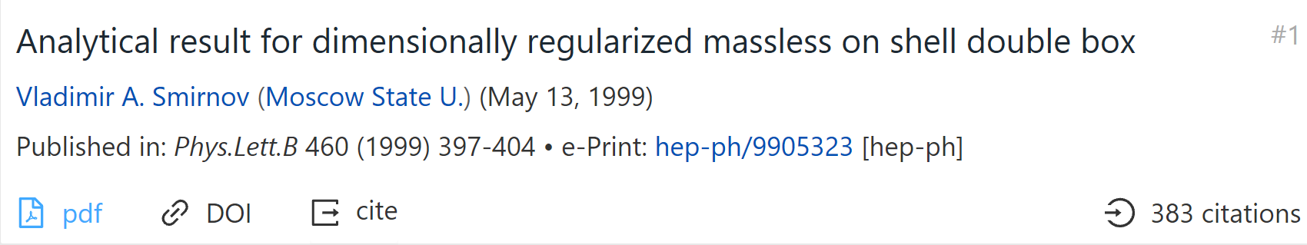
Based on MB representation
Planar

Slide 7
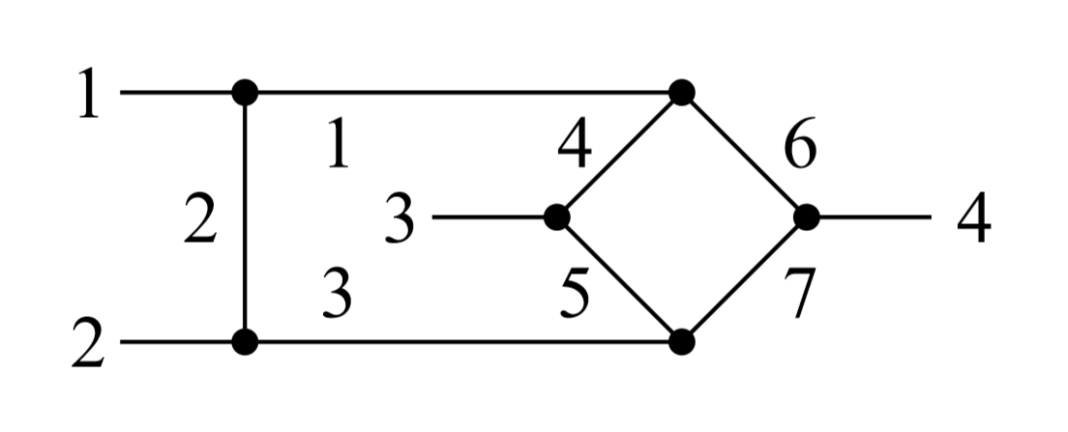
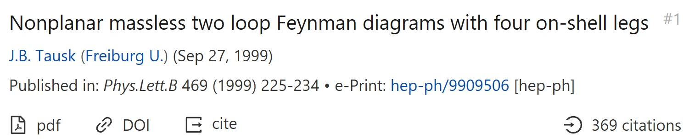
Nonplanar

Slide 8
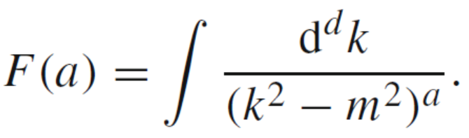
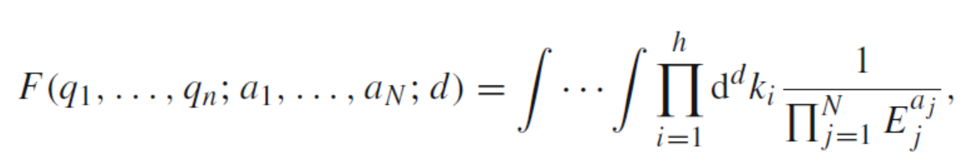
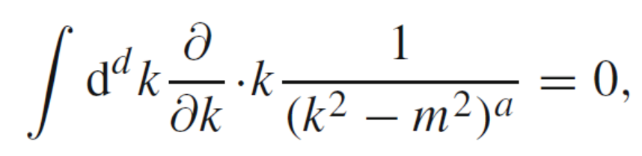
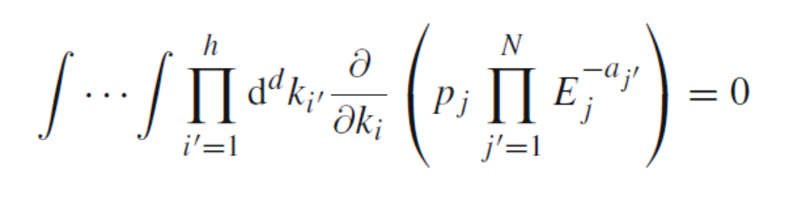
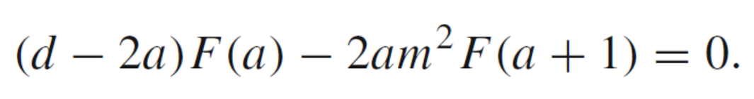
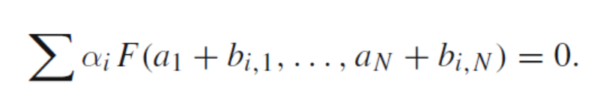
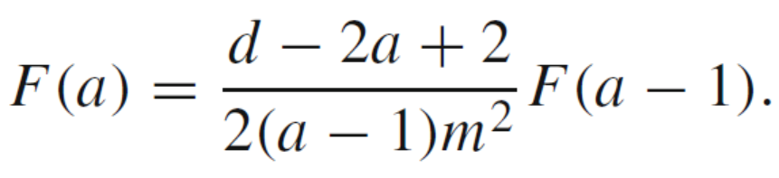
IBP (integration-by-parts)

Slide 9
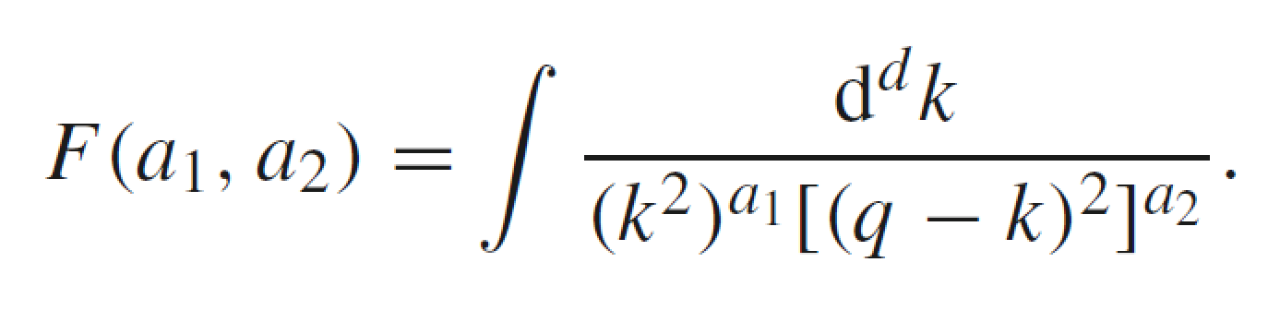
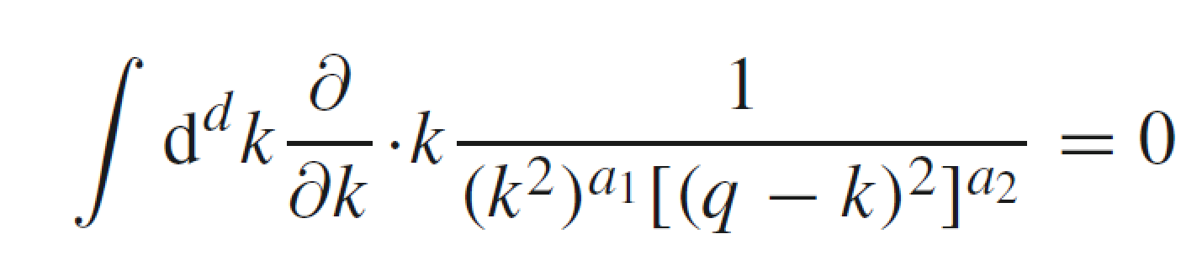
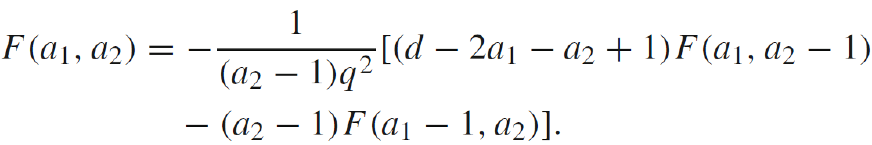
One more example on IBP reduction

Slide 10
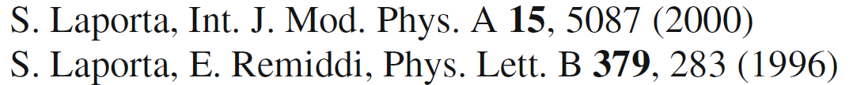
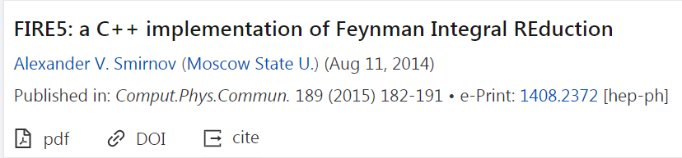
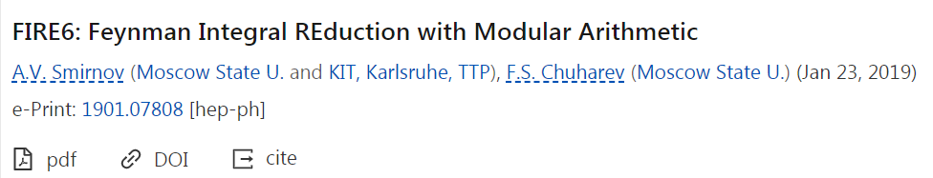
Reduction Packages:
FIRE, Reduze, Kira…

Slide 11
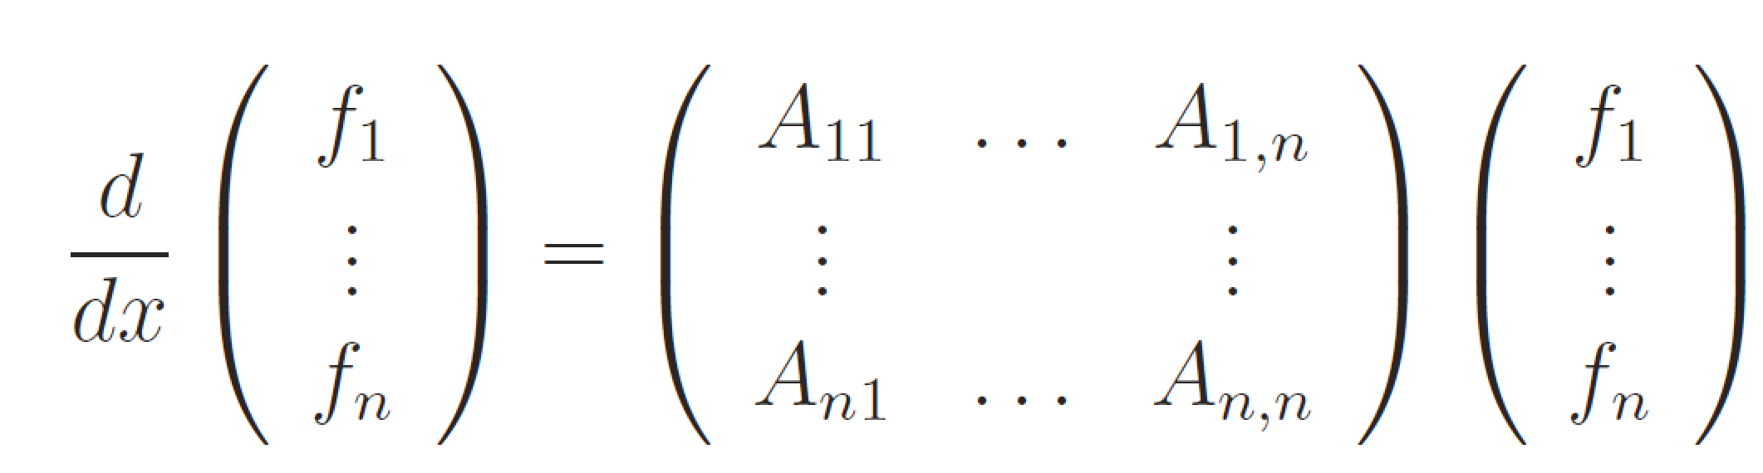
Method: Differential Equations (DE)
x are Lorentz invariant kinematics

Slide 12
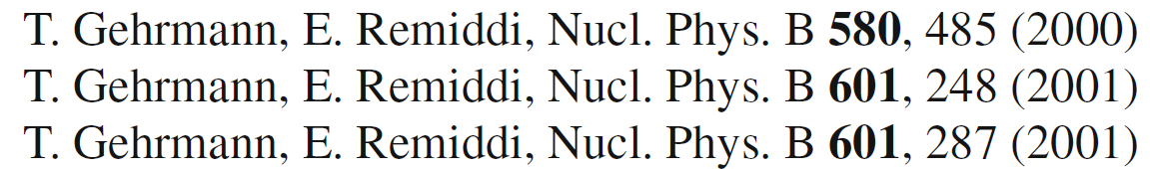
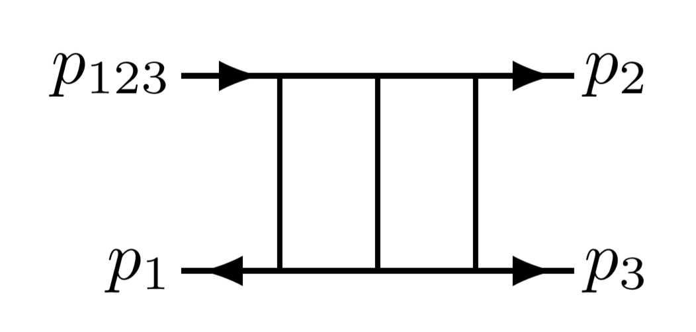
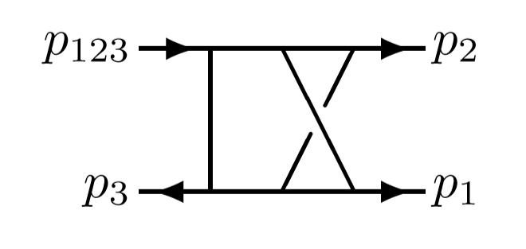
Progress in DE method:

Slide 13
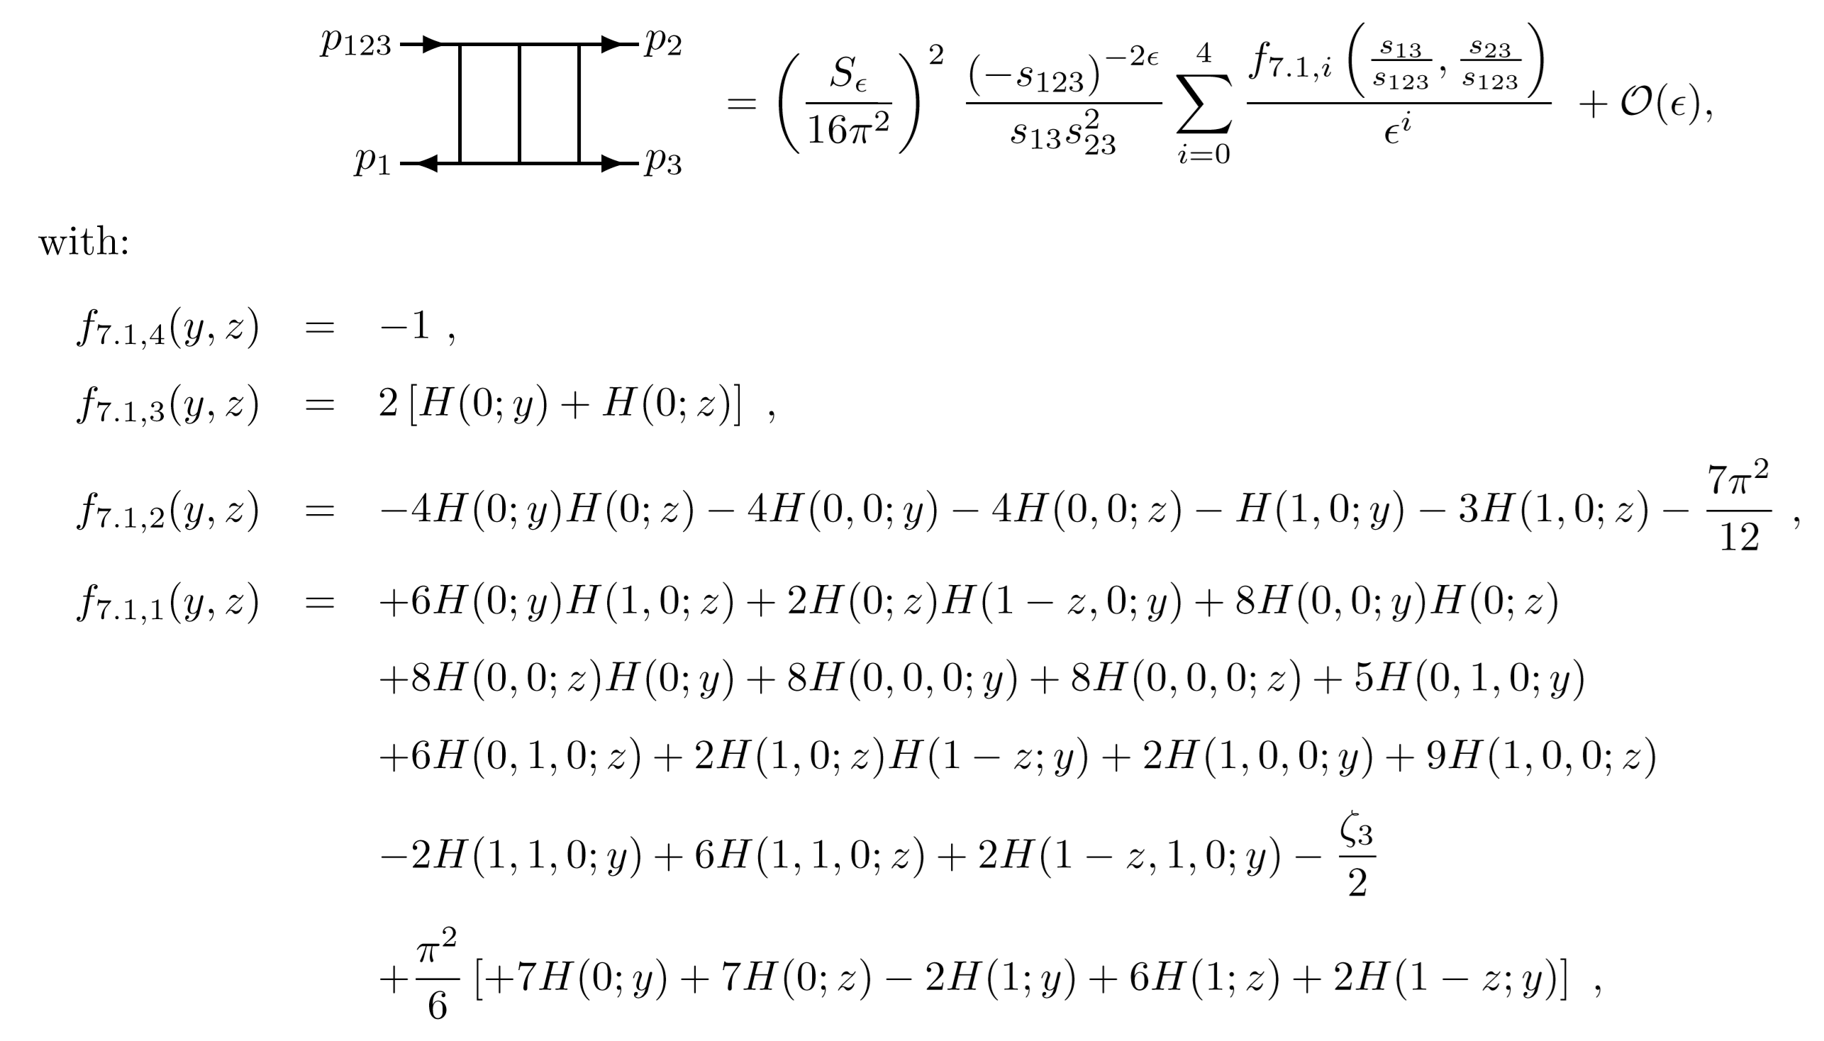

Slide 14
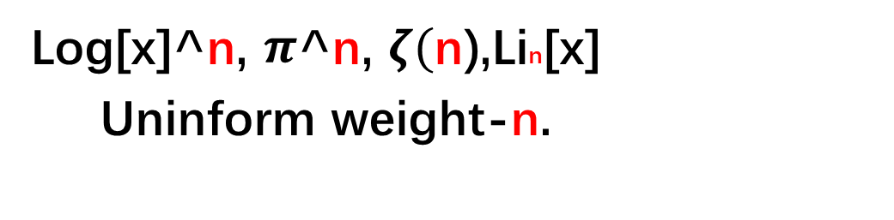
Weight
Log[x]^n, $π$^n, $ζ($n),Lin[x]
Uninform weight-n.

Slide 15

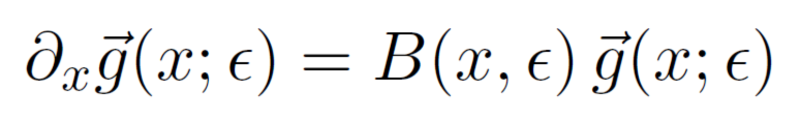
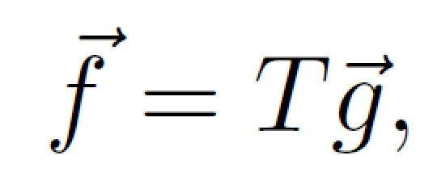
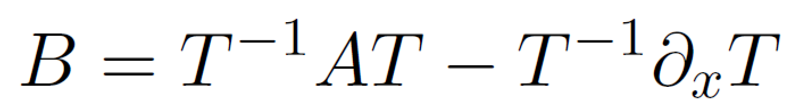
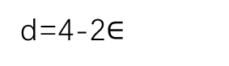
A suitable choice of basis (canonical basis)
arXiv:1304.1806
New Strategy
d=4-2$∈$

Slide 16
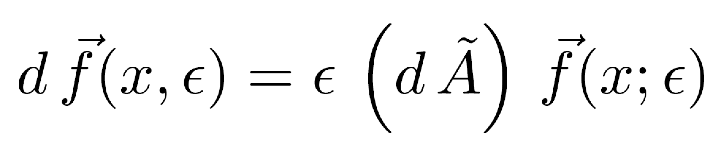

Slide 17
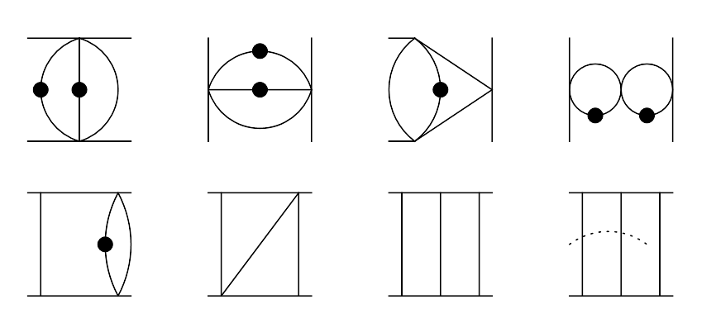
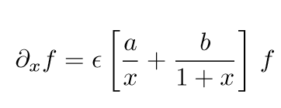

Slide 18
1. Two-loop master integrals for heavy-to-light form factors of two different massive fermions
Massive quark decays to massive quark
JHEP 02 (2018) 066

Slide 19
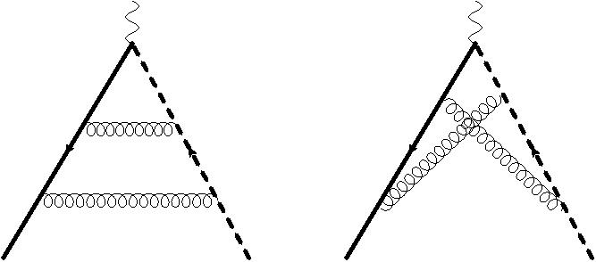
Sample of Two-loop Feynman diagrams

Slide 20
Tensor integrals are reduced by IBP (integrate-by-parts) method.
40 Master Integrals
Solid: Heavy; Dash solid: Light;
Thick: massless.

Slide 21
Three scales: s,m1,m2

Slide 22
Method: Differential Equations (DE)
x are Lorentz invariant kinematics

Slide 23
Canonical Basis

Slide 24
Differential Equations In Canonical Form:
A_i are rational matrices

Slide 25
Determination of Boundary Conditions

Slide 26
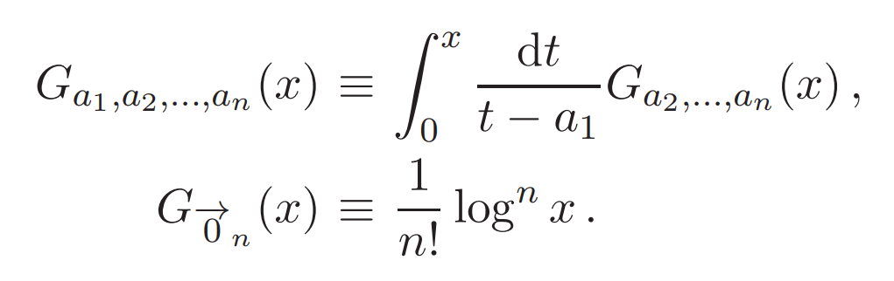
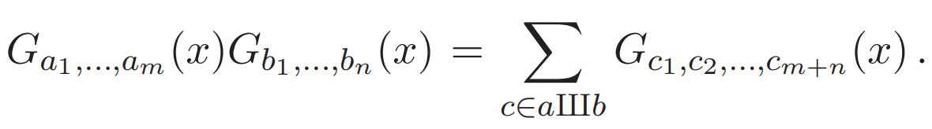
Goncharov Polylogarithms
GINAC

Slide 27
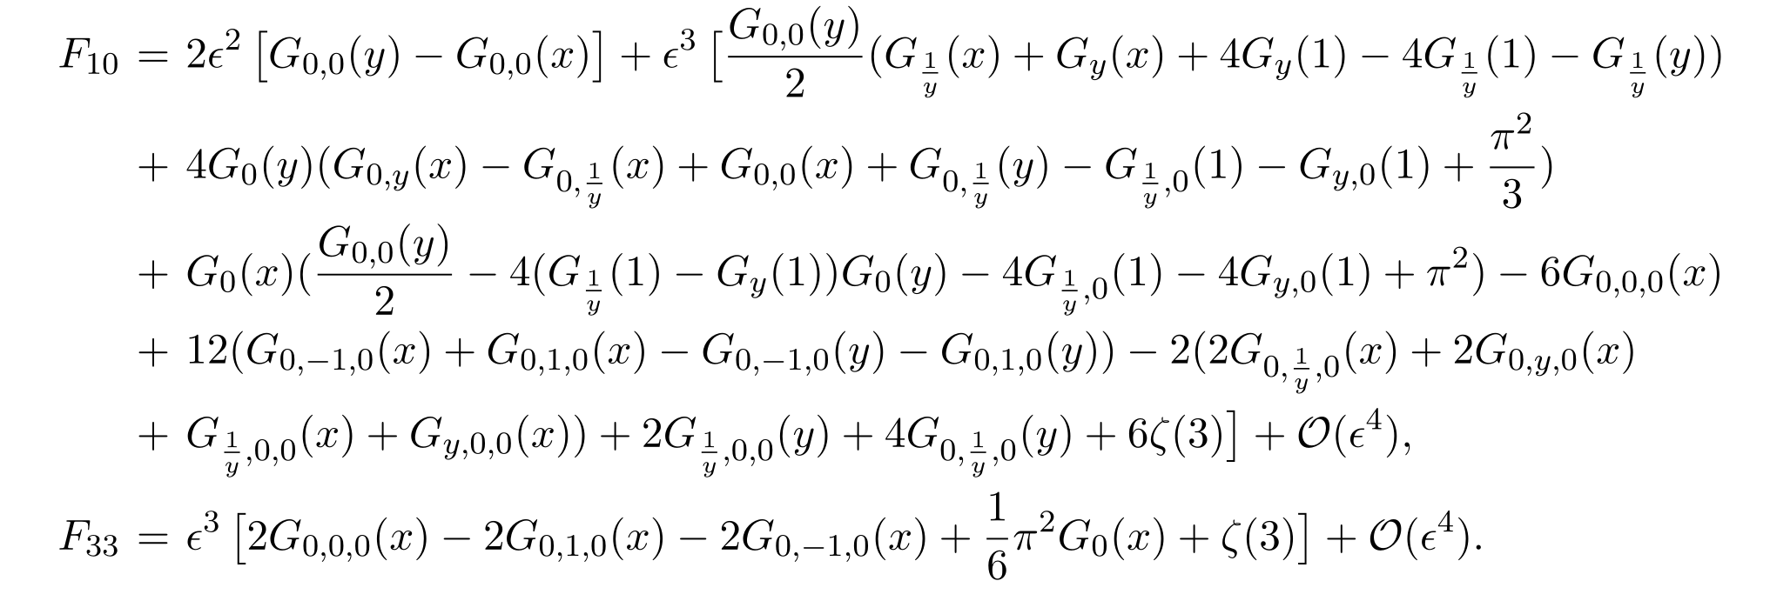
Results:
Goncharov Polylogarithms
Check:

Slide 28
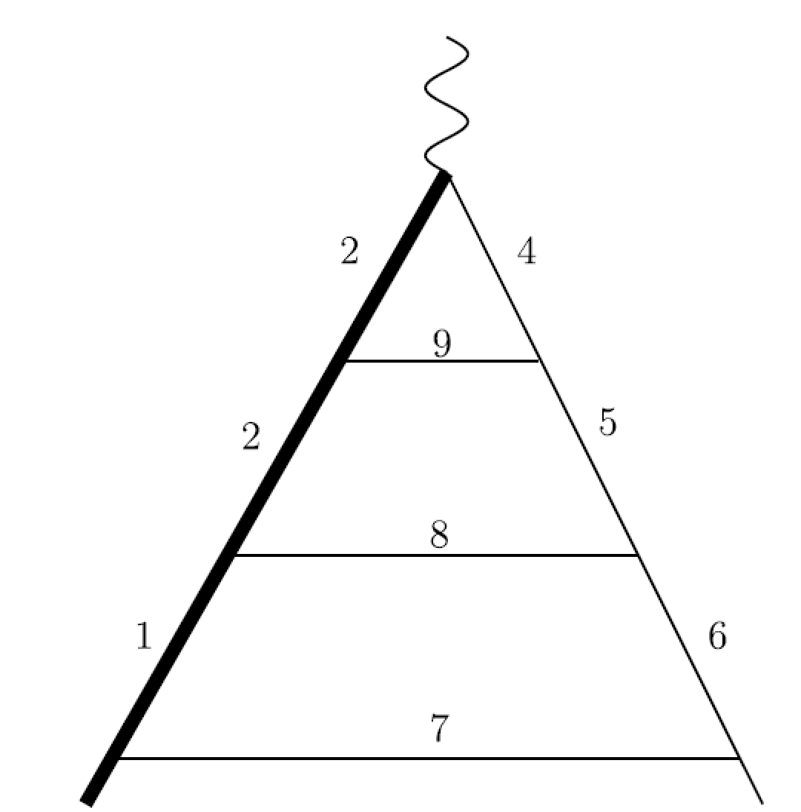
2. Three-Loop Heavy-to-light Form factors
W
t
b
Phys.Lett. B786 453

Slide 29
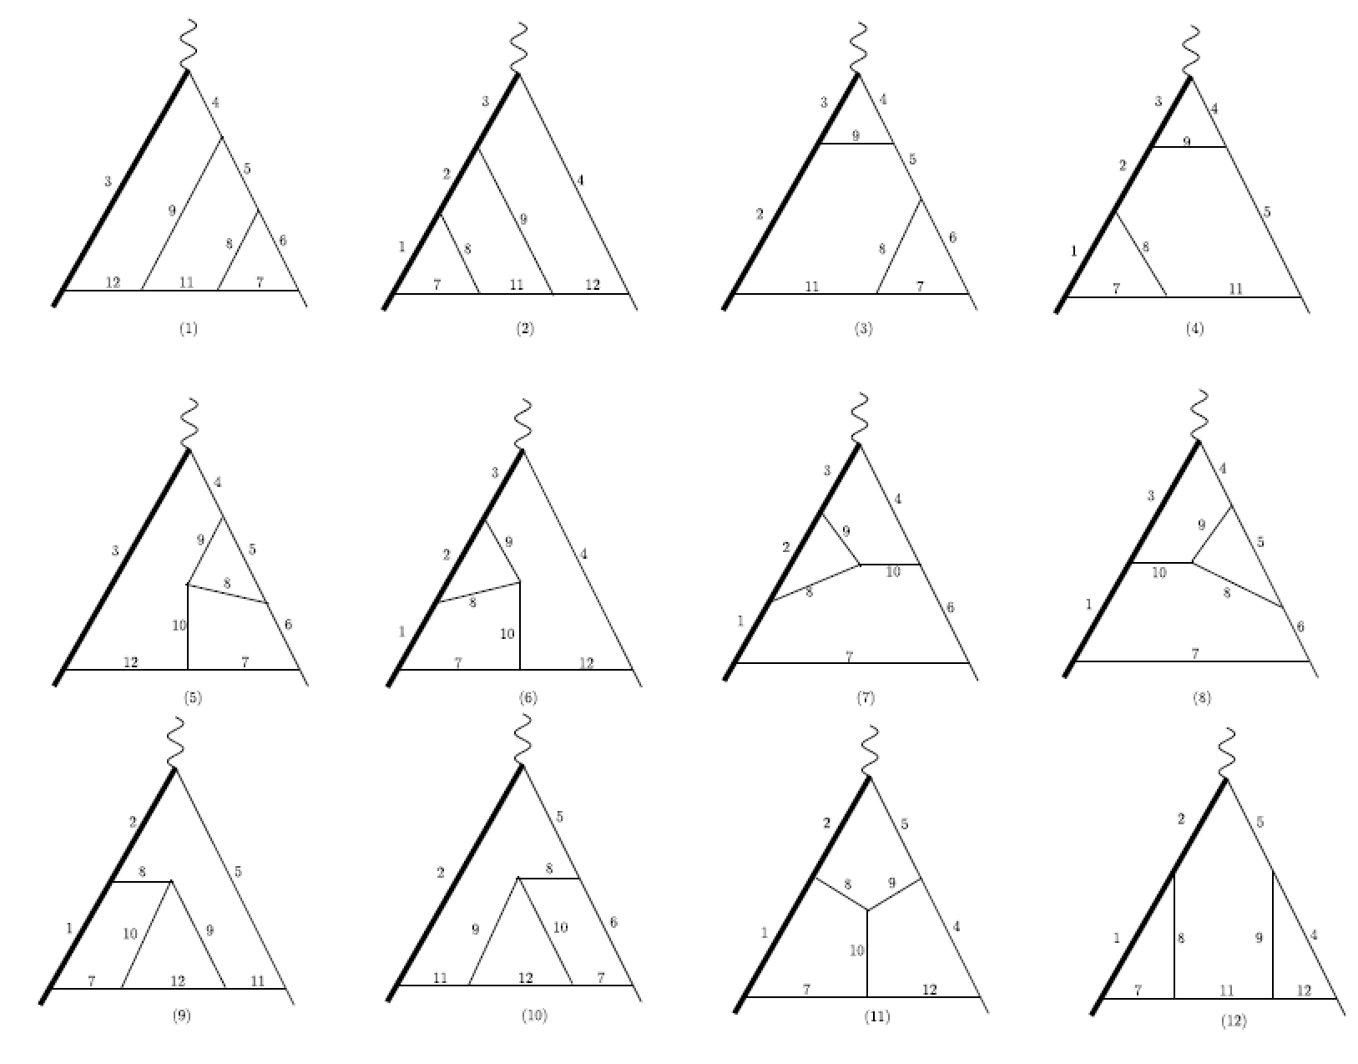
Color-planar diagrams （Leading Color Contribution）

Slide 30
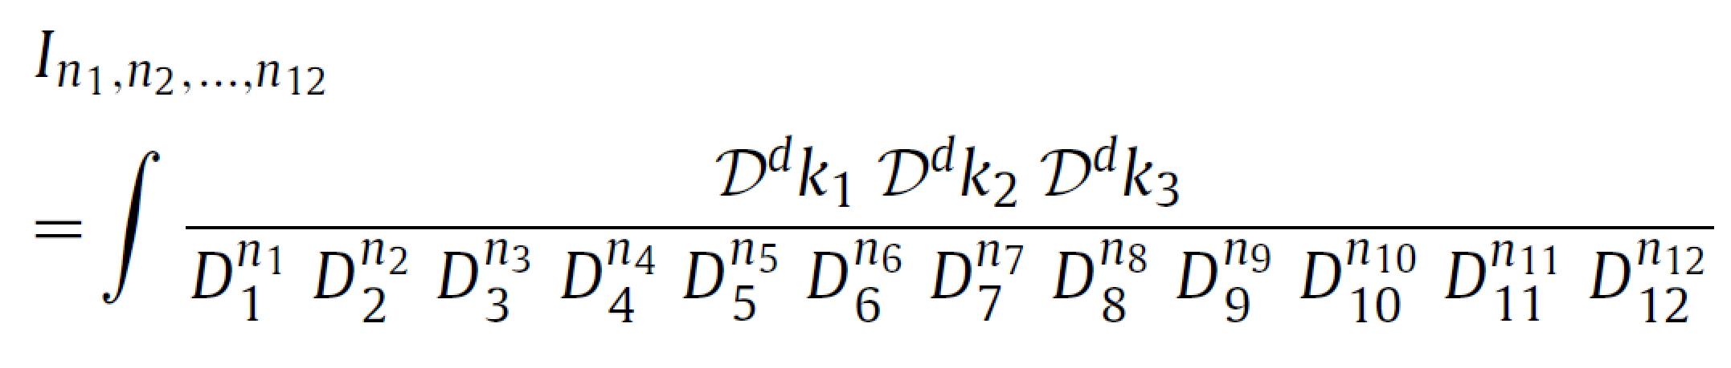
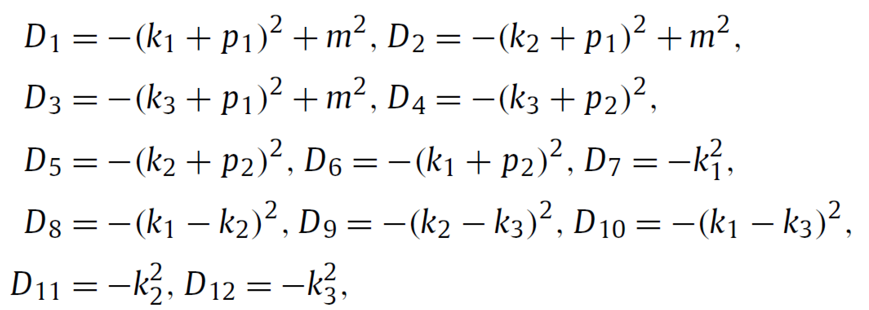
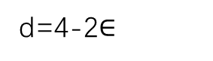
Integrals can be parameterized by
d=4-2$∈$
All integrals can be reduced to 71 Master Integrals

Slide 31
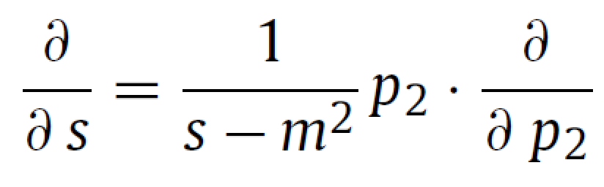
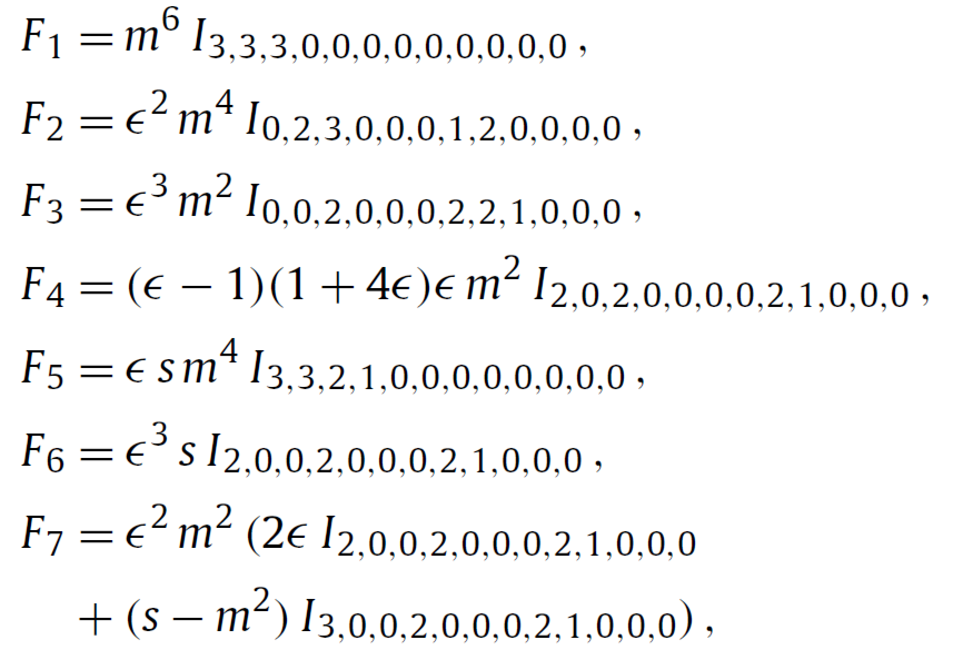
Canonical Basis:
………………………………………………………………

Slide 32
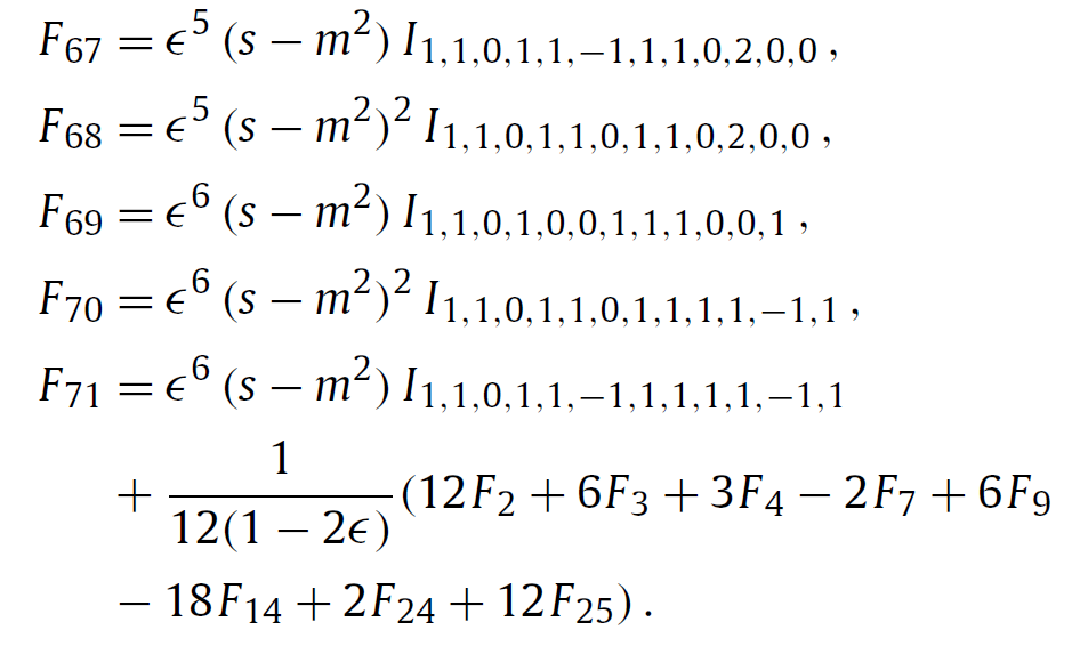

Slide 33
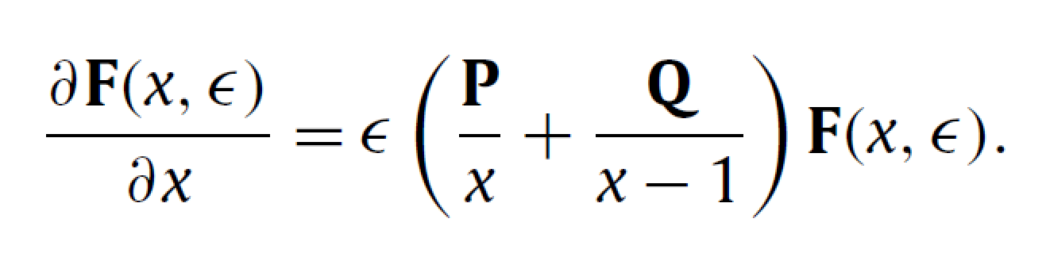
P and Q are 71*71 rational matrices

Slide 34

DE for non-canonical basis

Slide 35


Slide 36



Boundary Conditions
Known
Regular at x=0

Slide 37




Slide 38

Results of Boundary conditions are expressed in terms of zeta functions.

Slide 39

H are Harmonic Polylogarithms

Slide 40


Check:（s=-1.3,m=1.0）
FIESTA packages

Slide 41


3. Master integrals of a planar double-box family for top-quark pair production
Planar master integrals for top quark pairs hardron productions
Phys.Lett. B792 50

Slide 42


Two-loop Master integrals whose analytic results are unknown (gg->t tbar)
Planar
Non-Planar

Slide 43



Slide 44

4. Master Integrals for two-loop QCD corrections to Quark Quasi PDFs [arXiv:2006.10917]

Slide 45



Slide 46
Thanks!

